Slide 1

MASTER’S DEGREE IN COMPUTER ENGINEERING
QUANTUM COMPUTING AND QUANTUM INTERNET
PROJECT DISCUSSION
E91 PROTOCOL
PROFESSORS
STUDENT
LUCIANO LENZINI
LEONARDO BACCIOTTINI
GIOVANNI LIGATO
UNIVERSITY OF PISA

Slide 2

MASTER’S DEGREE IN COMPUTER ENGINEERING
QUANTUM COMPUTING AND QUANTUM INTERNET
PROJECT DISCUSSION
E91 PROTOCOL
PROFESSORS
STUDENT
LUCIANO LENZINI
LEONARDO BACCIOTTINI
GIOVANNI LIGATO
UNIVERSITY OF PISA

Slide 3

INTRODUCTION
Securely sharing cryptographic keys over insecure channels is a fundamental challenge in modern cryptography.
BACKGROUND
Classical key distribution methods rely on computational hardness, which can be broken by advances in computing.
THE PROBLEM
The E91 protocol leverages quantum mechanics (entanglement and the no-cloning theorem) to enable infinitely secure key distribution, immune to eavesdropping.
SOLUTION

Slide 4

INTRODUCTION
MAYBE Follow:
Background
Problem statement,
Solution…
Do not represent the protocol from scratch…
INSECURE CHANNEL
EXCHANGE SECRET KEY ALICE AND BOB

Slide 5






CHALLENGES
PROTOCOL DETAILS
BOB
ALICE
THE STATE ?
$$B_{0} = Z$$
$$A_{0} = Z$$
OBSERVABLES
$$B_{1} = \frac{Z−X}{\sqrt{2}}$$
$$A_{1} = X$$
$$A_{2} = \frac{Z+X}{\sqrt{2}}$$
$$B_{2} = \frac{Z+X}{\sqrt{2}}$$
CHSH CORRELATION VALUE
$$S= | \left\langle A_{0}B_{2} \right\rangle +\left\langle A_{0}B_{1} \right\rangle +\left\langle A_{1}B_{2} \right\rangle − ⟨ A_{1}B_{1} ⟩ |$$
0-indexed as in the Python code to avoid confusion between slides and implementation

Slide 6
SCENARIOS TO ANALYZE
Ideal Conditions
Channel Errors
Eavesdropping

Slide 7

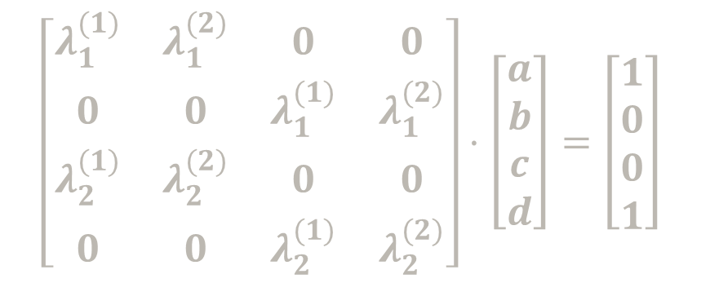



Osservabile -> Matrice hermitiana -> Autovalori reali -> Li posso leggere sullo schermo di un misuratore ->quando misuro collasso in uno degli autospazi generate dagli autovettori dell’orsservabile identificato dal relativo autovalore.
Passi da seguire: Sia O la mia osservabile
Trovo autovettori e relative autovalori
Bisogna trovare trasformazione unitaria che mappi autovettori in stati della base standard.
Risoluzione sistema
Verificare che sia unitaria effettivamente
Portare questa trasformazione su qiskit
E poi misurare nella base standard, è come misurare secondo la mia osservabile di partenza O
LINEAR SYSTEM TO Solve
$$\left[\begin{matrix}λ_{1}^{(1)} & λ_{1}^{(2)} & 0 & 0 \\ 0 & 0 & λ_{1}^{(1)} & λ_{1}^{(2)} \\ λ_{2}^{(1)} & λ_{2}^{(2)} & 0 & 0 \\ 0 & 0 & λ_{2}^{(1)} & λ_{2}^{(2)}\end{matrix}\right]⋅\left[\begin{matrix}a \\ b \\ c \\ d\end{matrix}\right]=\left[\begin{matrix}1 \\ 0 \\ 0 \\ 1\end{matrix}\right]$$
$$|0⟩$$
$$|1⟩$$
$${|0⟩}_{A}$$
$U$

Slide 8

IN caso di eavesdropping si verificano degli errori tra le chaivi di alice e bob per il seguente motivo. Eve invia a Alcie e Bob solamente o |01> o |10>. Se loro misurano entrambi in Z non succeed nulla, ma se misurano in base WW, cosa succeed? Vediamolo subito.
Per misurare in base WW, si applica la seguente trasformazione U ad entrambi I qubit e poi si misura In base Z
$$\left[\begin{matrix}0.924 & 0.383 \\ −0.383 & 0.924\end{matrix}\right]$$
Consideriamo ad esempio caso in cui Eve manda |10>, per l’altro caso si procede in modo analogo.
$\left|10\right\rangle ⋅\left(U⨂U\right)=\left(0.383 | 0\right\rangle +0.924|1⟩) ⨂ (0.924\left|0\right\rangle −0.383|1⟩)=0.354|00⟩−0.147|01⟩+0.854|10⟩−0.354|11⟩$
Perciò effettivamente si posson ottenere tutti e 4 gli outcome, ed in particolare quando escono |00> e |11> si hanno risultati correlate e non anticorrelate e dunque si ha un errore nella generazione della chiave. In particolare la probabilità che si abbiano quesi errori è:
Considerando che WW è solo una delle due scelte possibili per la generazione della chiave (moltiplicando per ½ ) si ottiene la probabilità totale di avere errori nella chiave: 0.125
Perciò si dovrebbe avere un mismatch ratio di questo valore…
$0.354^{2}+0.354^{2}=0.251$
Risultati arrotondati a 3 cifre decimali qui nelle slide per una questione di presentazione, su python non si approssimano a così poche cifre, ma si considerano molte di più per Maggiore accuratezza.

Slide 9











THE SPECIALIZED CIRCUIT FOR GENERATING WERNER STATES
HELD BY CHARLIE
$${|0⟩}_{A}$$
$$R_{y}(θ)$$
$H$
$${|0⟩}_{B}$$
+
$X$
$H$
$$0_{C}$$
$$C=1$$
$$C=0$$
$$C=1$$
$$C=0$$
$$ρ_{AB}=\sin^{2}\left(\frac{θ}{2}\right)⋅\left|ψ^{−}\right\rangle \left\langle ψ^{−}\right| + \frac{\cos^{2}\left(\frac{θ}{2}\right)}{4}⋅I$$
THAT is a werner state if we put w(werner parameter) equals to:
Furthermore to obtain the fidelity from the werner parameter it is sufficient to:
$$w=\sin^{2}\left(\frac{θ}{2}\right)$$
$$F=\frac{3w+1 }{4}$$

Slide 10


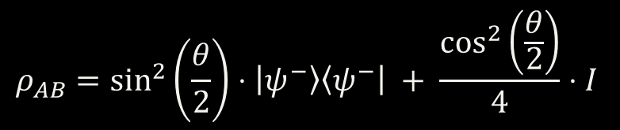







$${|0⟩}_{A}$$
$$R_{y}(θ)$$
$H$
$${|0⟩}_{B}$$
+
$X$
$H$
$$0_{C}$$
$$C=1$$
$$C=0$$
$$C=1$$
$$C=0$$
$$ρ_{AB}=\sin^{2}\left(\frac{θ}{2}\right)⋅\left|ψ^{−}\right\rangle \left\langle ψ^{−}\right| + \frac{\cos^{2}\left(\frac{θ}{2}\right)}{4}⋅I$$

Slide 11
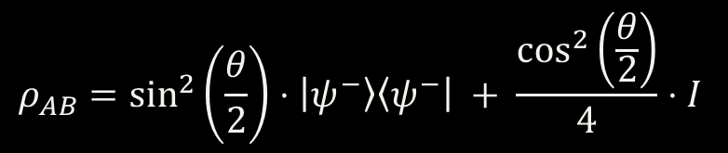


$$ρ_{AB}=\sin^{2}\left(\frac{θ}{2}\right)⋅\left|ψ^{−}\right\rangle \left\langle ψ^{−}\right| + \frac{\cos^{2}\left(\frac{θ}{2}\right)}{4}⋅I$$
THAT is a werner state if we put w(werner parameter) equals to:
Furthermore to obtain the fidelity from the werner parameter it is sufficient to:
$$w=\sin^{2}\left(\frac{θ}{2}\right)$$
$$F=\frac{3w+1 }{4}$$

Slide 12

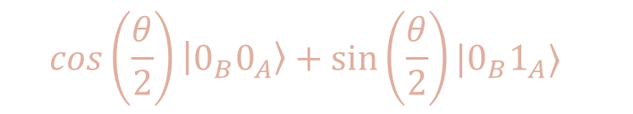

THE SPECIALIZED CIRCUIT FOR GENERATING WERNER STATES
HELD BY CHARLIE
$${|0⟩}_{A}$$
$$R_{y}(θ)$$
$H$
$${|0⟩}_{B}$$
+
$X$
$H$
$$0_{C}$$
$$C=1$$
$$C=0$$
$$C=1$$
$$C=0$$
$$\cos\left(\frac{θ}{2}\right)\left|0_{B}0_{A}\right\rangle +\sin\left(\frac{θ}{2}\right)|0_{B}1_{A}⟩$$
Measurement probabilities
$$P\left\{0_{A}\right\}=\cos^{2}\left(\frac{θ}{2}\right)$$
$$P\left\{1_{A}\right\}=\sin^{2}\left(\frac{θ}{2}\right)$$

Slide 13







In the ideal case, it is sufficient to put theta = 180° = \pi and the circuit simplifies to (after the measure of alice qubit)
$$P\left\{1_{A}\right\}=\sin^{2}\left(\frac{π}{2}\right)=1$$
$$P\left\{0_{A}\right\}=\cos^{2}\left(\frac{π}{2}\right)=0$$
$${|1⟩}_{A}$$
$H$
$$\left|ψ^{−}\right\rangle =\frac{\left|01\right\rangle −|10⟩}{\sqrt{2}}$$
$${|0⟩}_{B}$$
+
$X$

Slide 14

In the case of errors on the channel, they are simulated using the general circuit illustrated before using as theta values:
$$0≤θ<π$$
Noting that when theta = 0 at the output of the circuit there will be a completely depolarized state.

Slide 15









In the scenario where there is Eve that takes control of the site-generating entangled photon pairs and no more Charlie
$${|0⟩}_{A}$$
$${|0⟩}_{A}$$
$X$
$$|1_{B}0_{A}⟩$$
$$\frac{1}{2}$$
$$|0_{B}1_{A}⟩$$
$${|0⟩}_{B}$$
$X$
$${|0⟩}_{B}$$
PROBABILITY

Slide 16










In the scenario where there is Eve that takes control of the site-generating entangled photon pairs and no more Charlie
$${|0⟩}_{A}$$
$$\frac{1}{2}$$
$$|1_{B}0_{A}⟩$$
$${|0⟩}_{B}$$
$X$
PROBABILITY
$${|0⟩}_{A}$$
$X$
$$\frac{1}{2}$$
$$|0_{B}1_{A}⟩$$
$${|0⟩}_{B}$$

Slide 17
IDEAL CONDITIONS
RESULTS
ALL THE PLOTS required in the project specifications

Slide 18
METRICS TO EVALUATE
S e Rmis al variare di theta

Slide 19
CHANNEL ERRORS
EXPLAIN HOW THEY ARE INTRODUCED VIA THE SPECIALIZED CIRCUIT
ADD THE SCREEN OF THE CIRCUIT AND FORMULAS…
$$w⋅\left|ψ^{−}\right\rangle \left\langle ψ^{−}\right| + \frac{1−w}{4}⋅I$$
$$R_{mis}=\frac{\#mismatchedbits}{totalkeylength }$$

Slide 20

EXPERIMENT PARAMETERS
n
NUMBER OF EXECUTIONS PER SETTING
$$θ$$
THETA VALUES USED FOR GENERATING THE WERNER STATES
Eavesdropping
WHETHER EVE IS EAVESDROPPING OR NOT
#EPR Pairs
NUMBER OF EPR PAIRS GENERATED IN ONE PROTOCOL EXECUTION

Slide 21

EXPERIMENT PARAMETERS
n
NUMBER OF EXECUTIONS PER SETTING
$$θ$$
THETA VALUES USED FOR GENERATING THE WERNER STATES
Eavesdropping
WHETHER EVE IS EAVESDROPPING OR NOT
#EPR Pairs
NUMBER OF EPR PAIRS GENERATED IN ONE PROTOCOL EXECUTION

Slide 22

n
NUMBER OF EXECUTIONS PER SETTING
$$θ$$
THETA VALUES USED FOR GENERATING THE WERNER STATES
EXPERIMENT PARAMETERS
Eavesdropping
WHETHER EVE IS EAVESDROPPING OR NOT
#EPR Pairs
NUMBER OF EPR PAIRS GENERATED IN ONE PROTOCOL EXECUTION

Slide 23








EXPERIMENT CONFIGURATION
RESULTS WITH FOLLOWIN SETTING:
# Number of times the protocol is executed for each setting
n = 30
# Theta values to be used for the generation of the Werner States
theta_values = np.linspace(0, np.pi, 15)
# Whether Eve is eavesdropping or not
eavesdropping = False
# Number of EPR pairs to be generated in one execution of the protocol
epr_pairs = 300
n$→$30
$θ→\left[\frac{i}{14}π | i=0,1, …, 14\right]$
Eavesdropping $→$False
#EPR Pairs $→$ 300
n$→$30
$θ→\left[\frac{i}{14}π | i=0,1, …, 14\right]$
Eavesdropping $→$False
#EPR Pairs $→$ 300

Slide 24
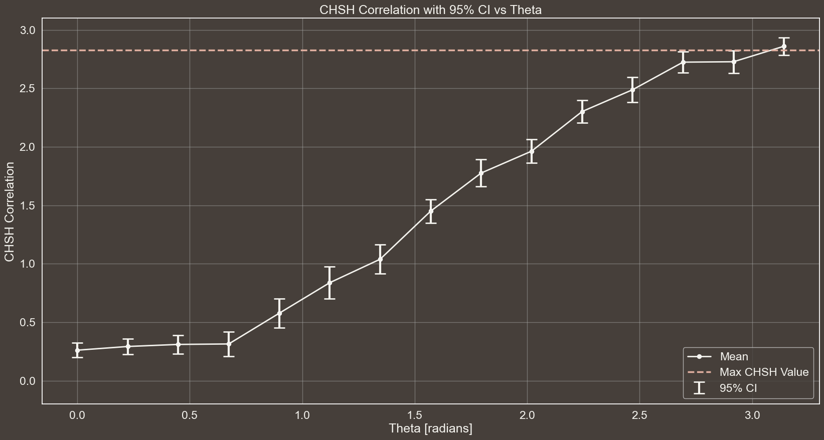
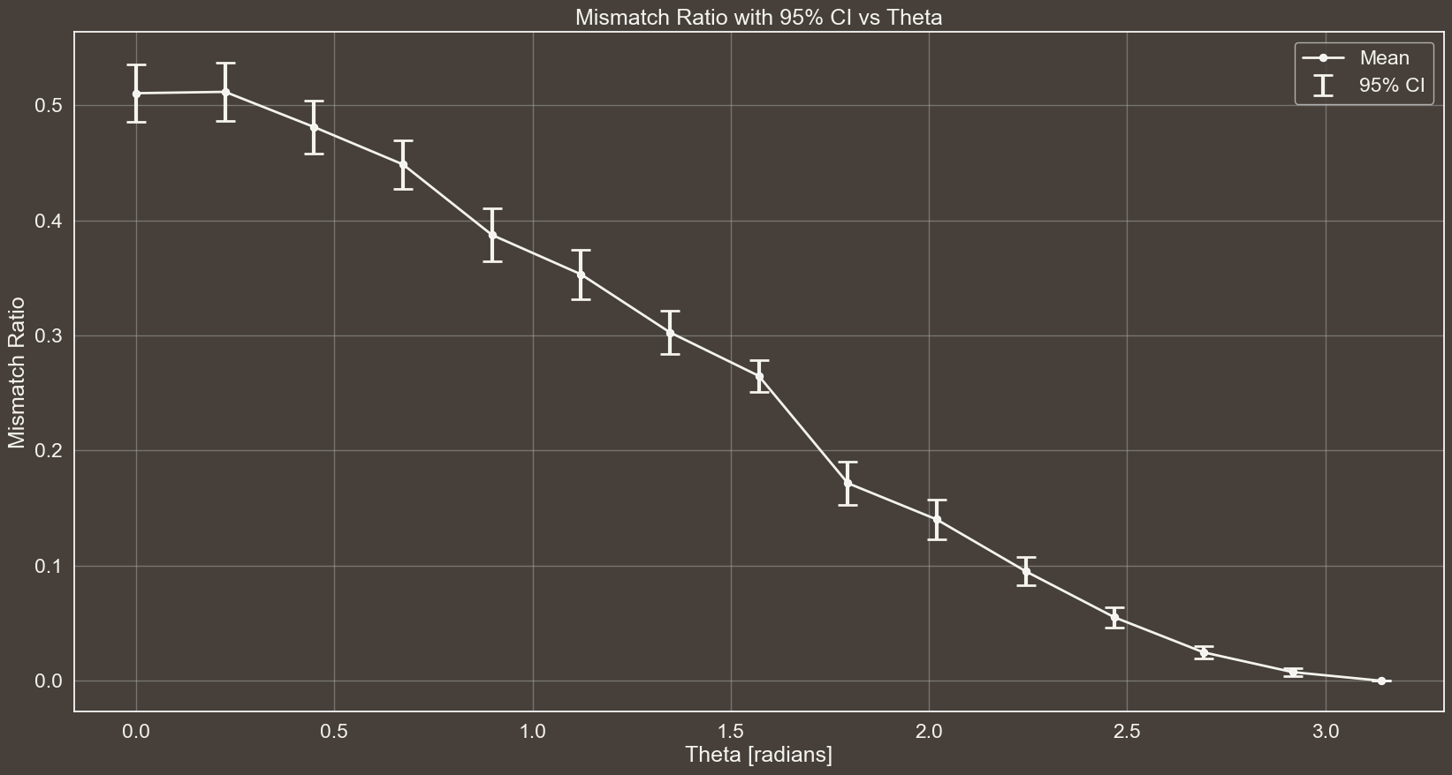



CHSH CORRELATION WITH 95% CI vs THETA
n$→$30
$θ→\left[\frac{i}{14}π | i=0,1, …, 14\right]$
Eavesdropping $→$False
#EPR Pairs $→$ 300

Slide 25




CHSH CORRELATION WITH 95% CI vs THETA
n$→$30
$θ→\left[\frac{i}{14}π | i=0,1, …, 14\right]$
Eavesdropping $→$False
#EPR Pairs $→$ 300

Slide 26
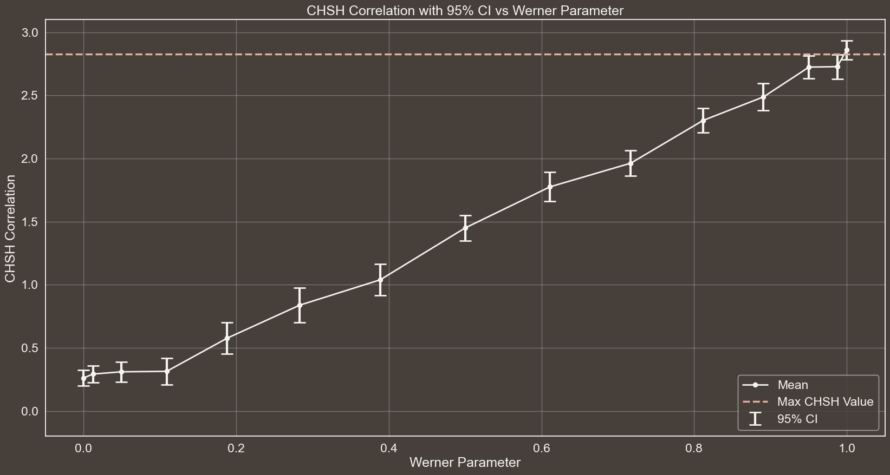
CHSH CORRELATION WITH 95% CI vs WERNER PARAMETER
n$→$30
$θ→\left[\frac{i}{14}π | i=0,1, …, 14\right]$
Eavesdropping $→$False
#EPR Pairs $→$ 300

Slide 27
MISMATCH RATIO WITH 95% CI vs THETA
n$→$30
$θ→\left[\frac{i}{14}π | i=0,1, …, 14\right]$
Eavesdropping $→$False
#EPR Pairs $→$ 300

Slide 28
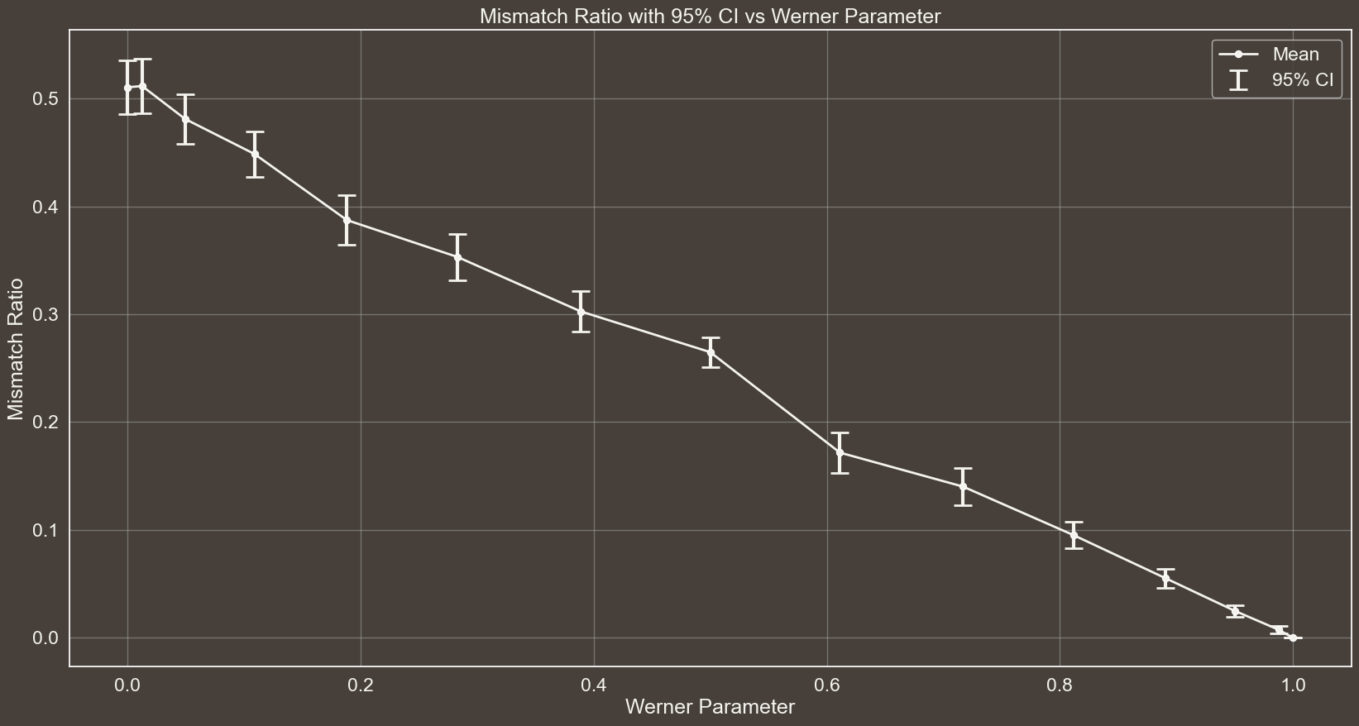
MISMATCH RATIO WITH 95% CI vs WERNER PARAMETER
n$→$30
$θ→\left[\frac{i}{14}π | i=0,1, …, 14\right]$
Eavesdropping $→$False
#EPR Pairs $→$ 300

Slide 29


RESULTS WITH FOLLOWIN SETTING:
# Number of times the protocol is executed for each setting
n = 30
# Theta values to be used for the generation of the Werner States
theta_values = np.linspace(0, np.pi, 15)
# Whether Eve is eavesdropping or not
eavesdropping = False
# Number of EPR pairs to be generated in one execution of the protocol
epr_pairs = 1000
n$→$30
$θ→\left[\frac{i}{14}π | i=0,1, …, 14\right]$
Eavesdropping $→$False
#EPR Pairs $→$ 1000

Slide 30
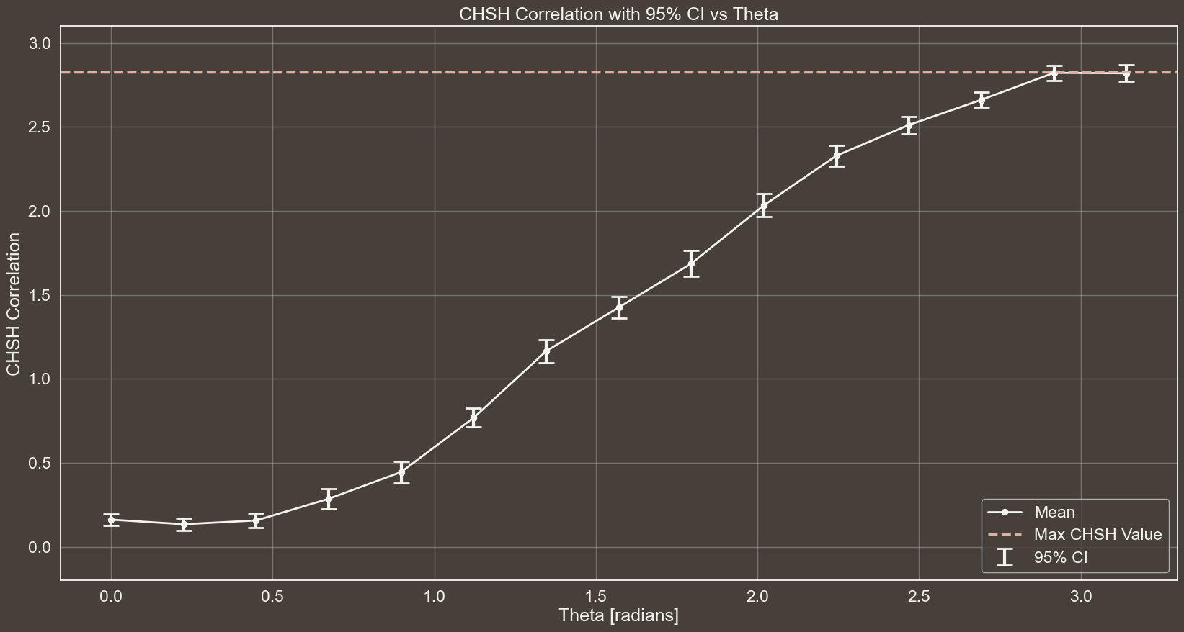
CHSH CORRELATION WITH 95% CI vs THETA
n$→$30
$θ→\left[\frac{i}{14}π | i=0,1, …, 14\right]$
Eavesdropping $→$False
#EPR Pairs $→$ 1000

Slide 31
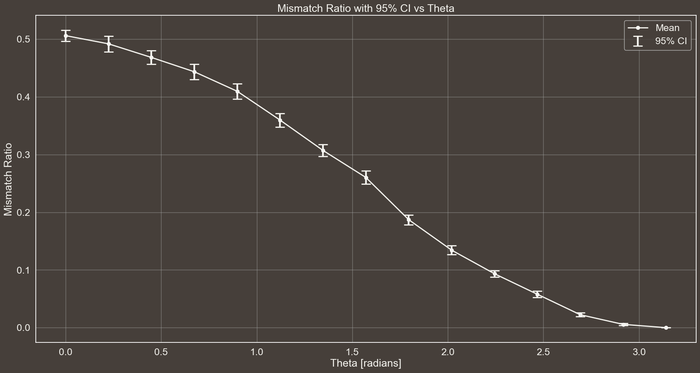
MISMATCH RATIO WITH 95% CI vs THETA
n$→$30
$θ→\left[\frac{i}{14}π | i=0,1, …, 14\right]$
Eavesdropping $→$False
#EPR Pairs $→$ 1000

Slide 32
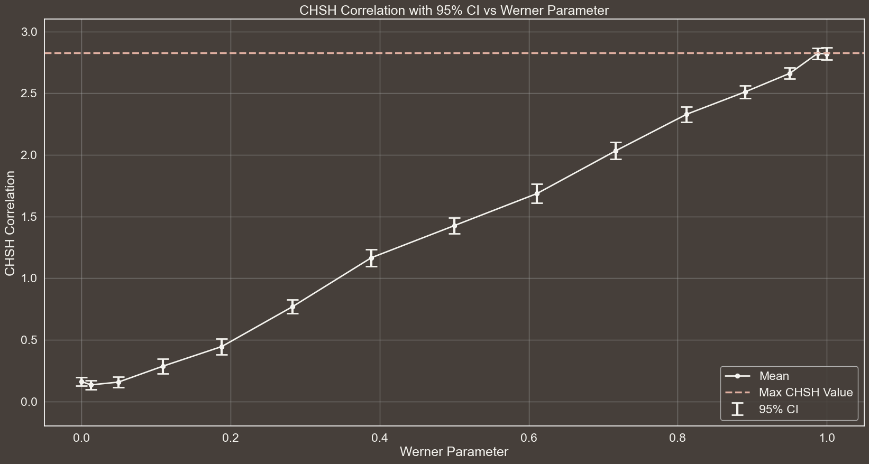
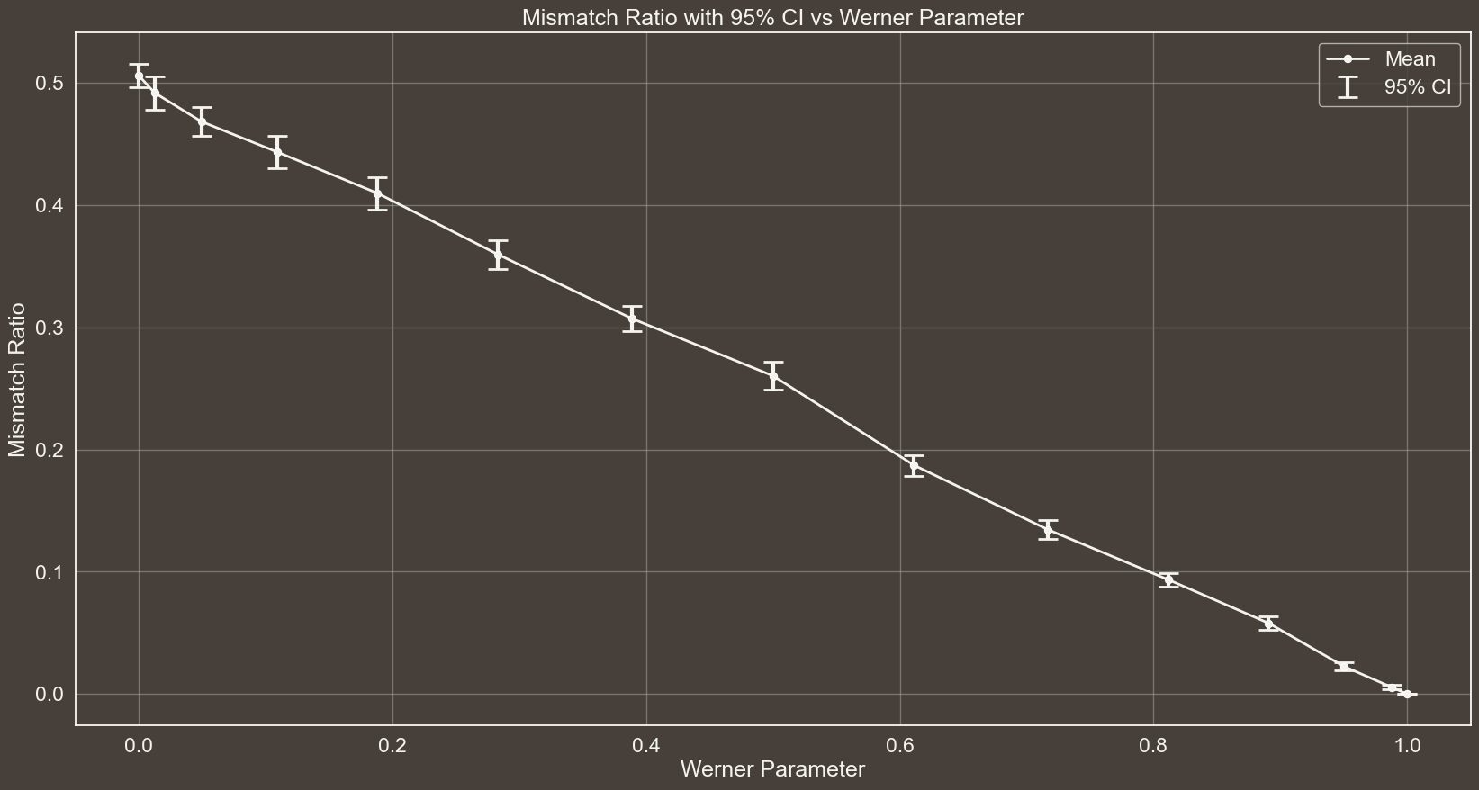

Slide 33




EXPLORING THE EFFECT OF #EPR PAIRS VARIATION
n$→$30
$θ→\left[\frac{i}{14}π | i=0,1, …, 14\right]$
Eavesdropping $→$False
#EPR Pairs $→$ 1000

Slide 34


RESULTS WITH FOLLOWIN SETTING:
# Number of times the protocol is executed for each setting
n = 30
# Theta values to be used for the generation of the Werner States
theta_values = np.linspace(0, np.pi, 15)
# Whether Eve is eavesdropping or not
eavesdropping = False
# Number of EPR pairs to be generated in one execution of the protocol
epr_pairs = 80
n$→$30
$θ→\left[\frac{i}{14}π | i=0,1, …, 14\right]$
Eavesdropping $→$False
#EPR Pairs $→$ 80

Slide 35
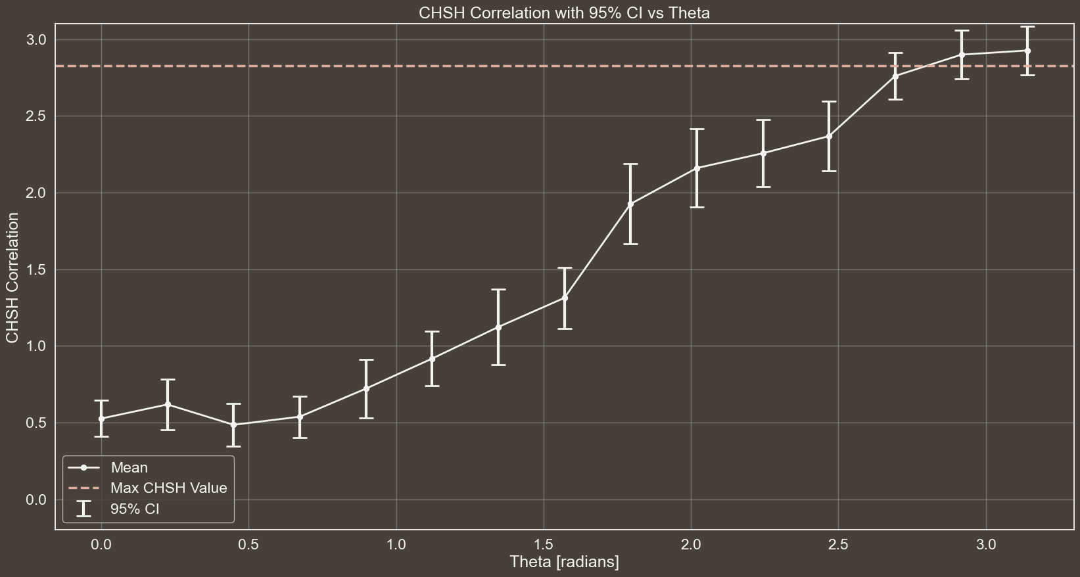
CHSH CORRELATION WITH 95% CI vs THETA
n$→$30
$θ→\left[\frac{i}{14}π | i=0,1, …, 14\right]$
Eavesdropping $→$False
#EPR Pairs $→$ 80

Slide 36
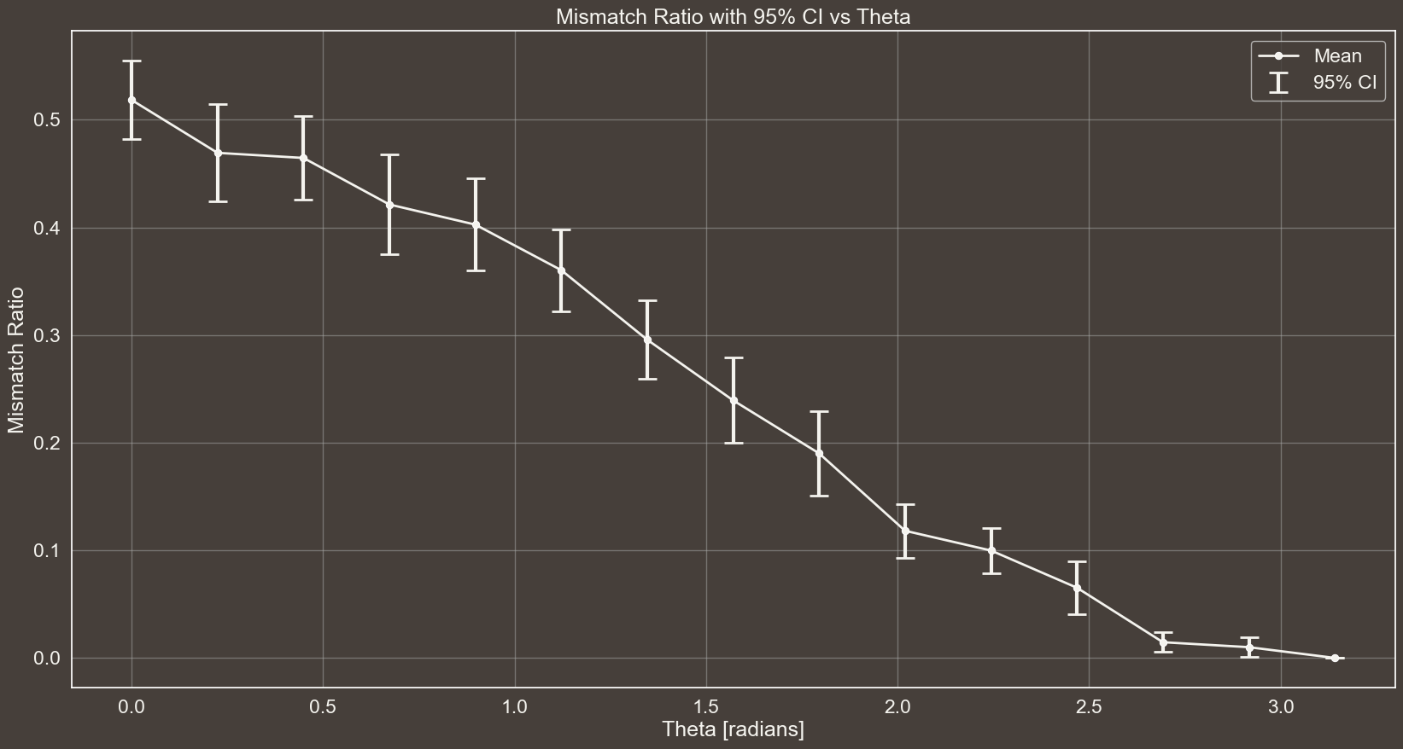
MISMATCH RATIO WITH 95% CI vs THETA
n$→$30
$θ→\left[\frac{i}{14}π | i=0,1, …, 14\right]$
Eavesdropping $→$False
#EPR Pairs $→$ 80

Slide 37

n$→$30
$θ→\left[\frac{i}{14}π | i=0,1, …, 14\right]$
Eavesdropping $→$False
#EPR Pairs $→$ 80

Slide 38
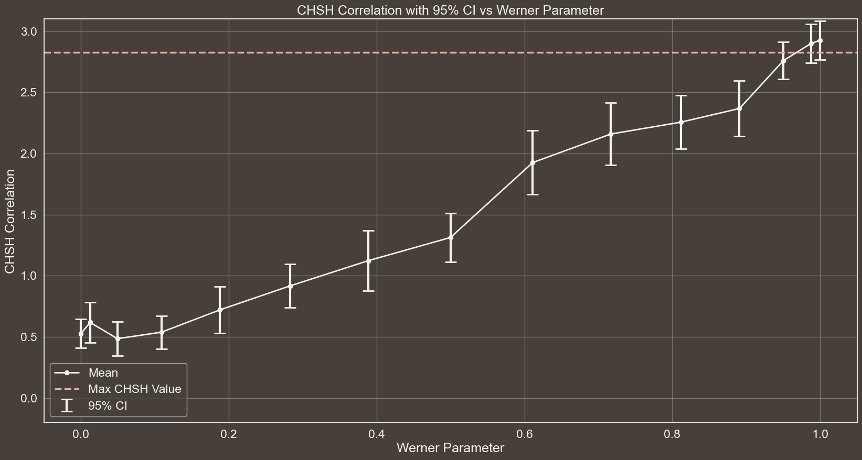
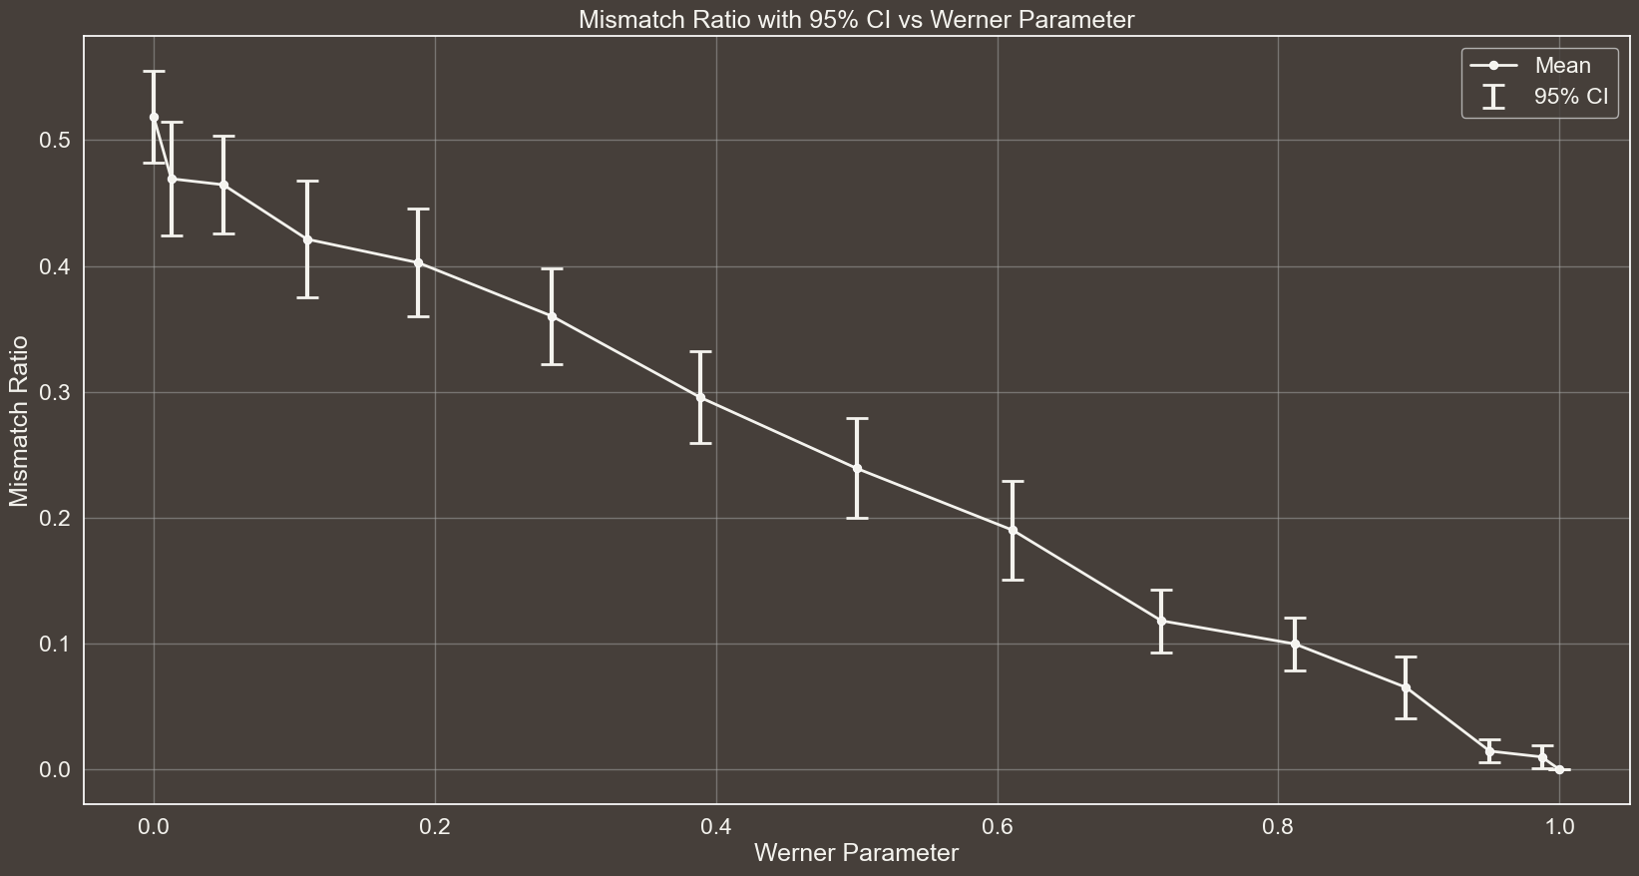

Slide 39




RESULTS WITH FOLLOWIN SETTING:
# Number of times the protocol is executed for each setting
n = 30
# Theta values to be used for the generation of the Werner States
theta_values = [np.pi] # np.linspace(0, np.pi, 15)
# Whether Eve is eavesdropping or not
eavesdropping = True
# Number of EPR pairs to be generated in one execution of the protocol
epr_pairs = 300
n$→$30
$θ→\left[π\right]$
Eavesdropping $→$True
#EPR Pairs $→$ 300

Slide 40
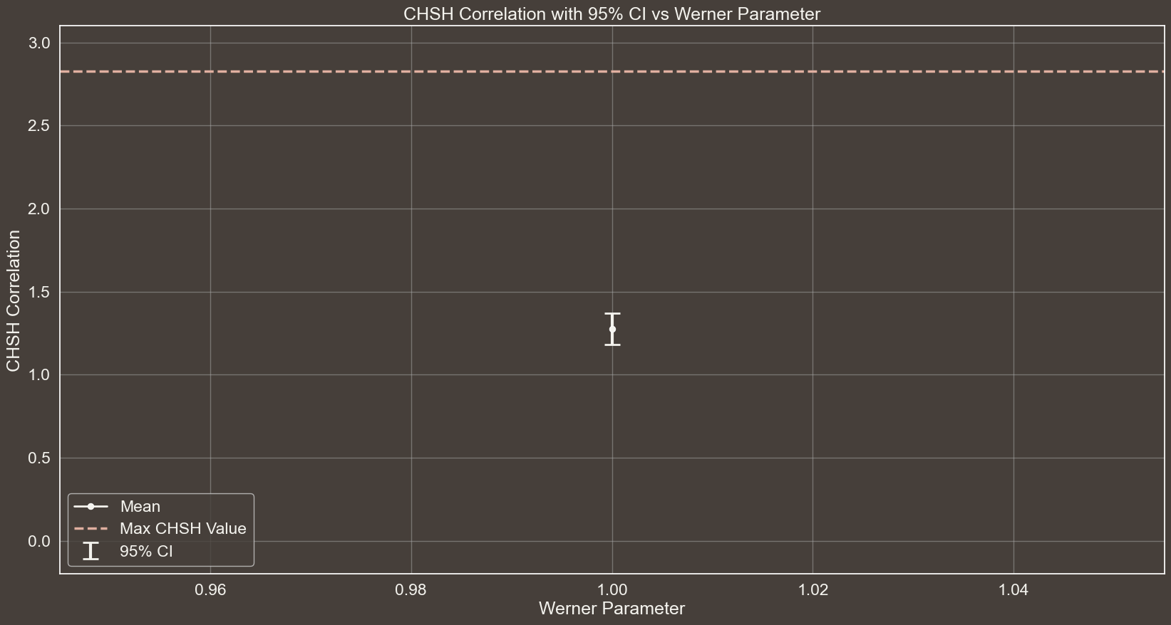
CHSH CORRELATION WITH 95% CI vs WERNER PARAMETER
n$→$30
$θ→\left[π\right]$
Eavesdropping $→$True
#EPR Pairs $→$ 300

Slide 41
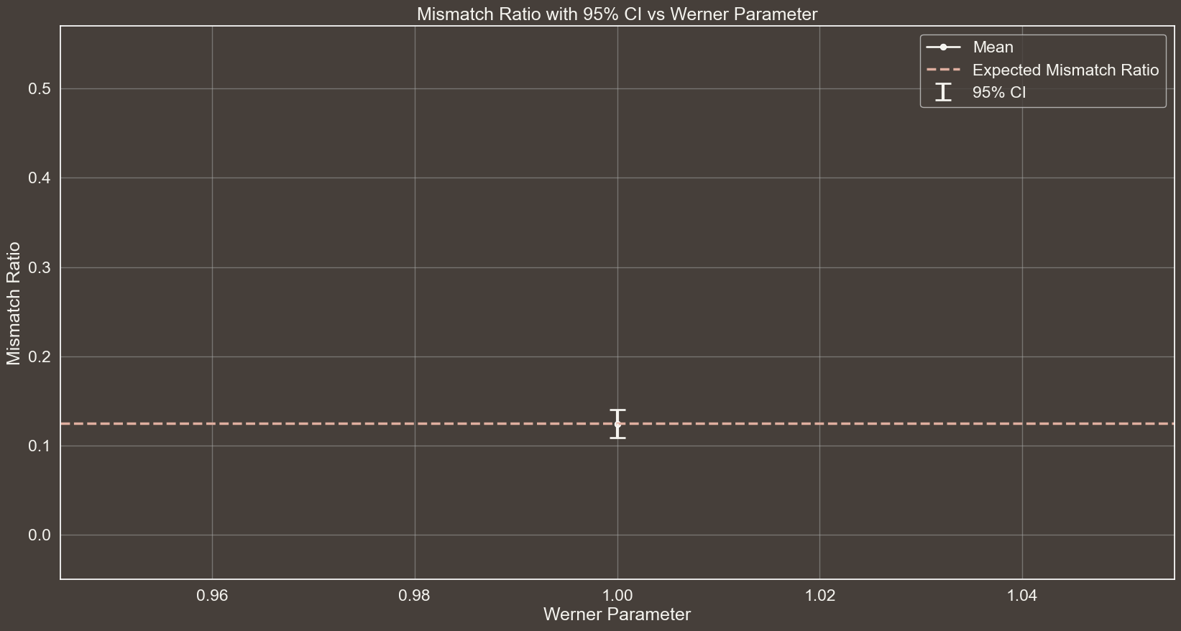
MISMATCH RATIO WITH 95% CI vs WERNER PARAMETER
n$→$30
$θ→\left[π\right]$
Eavesdropping $→$True
#EPR Pairs $→$ 300

Slide 42



EAVESDROPPING
GRAPH OF S WITH CI THAT IS BELOW 2sqrt(2)
Spiegare a cosa sono dovuti gli errori in questo caso… Il fatto che se misuro in base W e ho 01 o 10 allora posso ottenere tutti gli outcome con diverse probabilità
$$|01⟩$$
$$\frac{1}{2}$$
$$|10⟩$$

Slide 43
REFERENCES
[1]
CHSH INEQUALITY
https://en.wikipedia.org/wiki/CHSH_inequality
[2]
QUANTUM CORRELATION
https://en.wikipedia.org/wiki/Quantum_correlation
[3]
TSIRELSON'S BOUND
https://en.wikipedia.org/wiki/Tsirelson's_bound
Notes:
Didi Chuxing implementa il monitoraggio telemetrico della guida (algoritmo di machine learning per verificare frenate brusche, accelerazioni brusche e altri parametri che definiscono una guida pericolosa.

Slide 44


REFERENCES
[1]
CHSH INEQUALITY
https://en.wikipedia.org/wiki/CHSH_inequality
https://coolors.co/palette/463f3a-8a817c-bcb8b1-f4f3ee-e0afa0
[2]
QUANTUM CORRELATION
https://en.wikipedia.org/wiki/Quantum_correlation
[3]
TSIRELSON'S BOUND
https://en.wikipedia.org/wiki/Tsirelson's_bound
www.flaticon.com
Notes:
Didi Chuxing implementa il monitoraggio telemetrico della guida (algoritmo di machine learning per verificare frenate brusche, accelerazioni brusche e altri parametri che definiscono una guida pericolosa.

Slide 45
THANKS
FOR YOUR ATTENTION

Slide 46

MASTER’S DEGREE IN COMPUTER ENGINEERING
INTELLIGENT SYSTEMS
PROJECT DISCUSSION
Comparative Analysis of Deep Learning Models for Brain Tumor Segmentation in MRI Images
PROFESSORS
STUDENT
PIETRO DUCANGE
FABRIZIO RUFFINI
GIOVANNI LIGATO
University of Pisa

Slide 47

Brain Tumors directly impair Brain function, affecting cognition, mood and personality.
Timely detection of these Tumors is crucial, as recognizing the initial stages of a Brain Tumor can profoundly influence a patient’s prognosis.
BACKGROUND
Reading and interpreting MRI scans is an intricate process. Indeed, it is estimated that in 5-10% of scans, a relevant Pathology is missed.
THE PROBLEM
Intelligent Systems to automatically identify and segment Regions Of Interest (ROI).
SOLUTION

Slide 48
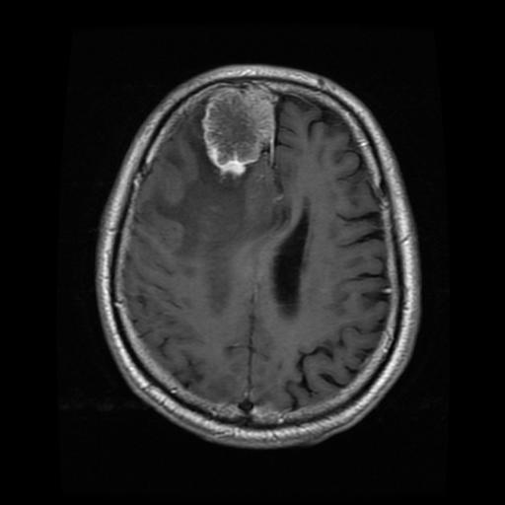
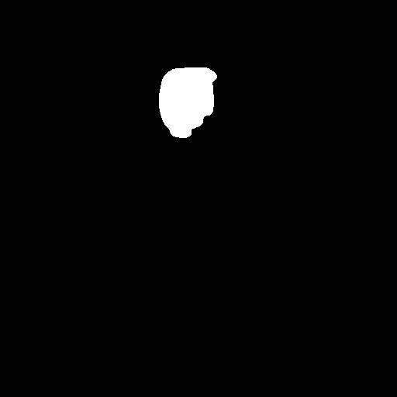

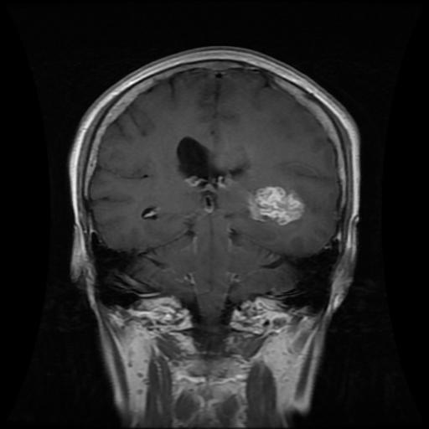


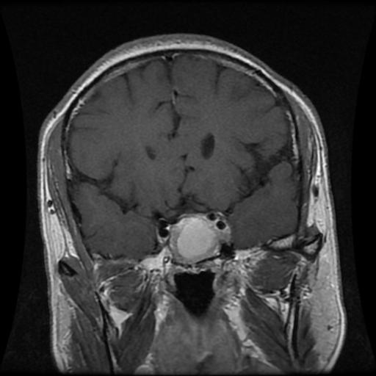


DATASET
MENINGIOMA
708
Collected from two Hospitals in China between 2005 and 2010.
GLIOMA
1426
233 Patients
PITUITARY
930
The Tumor regions were manually segmented by three experienced radiologists.

Slide 49


YOLOv8n-seg 3.4
YOLOv8s-seg 11.8
YOLOv8
YOLOv8m-seg 27.3
YOLOv8l-seg 46.0
YOLO
YOLOv8x-seg 71.8
DEEP LEARNING MODELS
YOLOv9c-seg 27.9
YOLOv9
YOLOv9e-seg 60.5
U-Net
1.94
Region Growing
0
CLASSICAL ALGORITHM
THIS COLOR SHOWS THE MODEL'S COMPLEXITY IN MILLIONS OF PARAMETERS

Slide 50
MAIN
.
2 | X ∩ Y |
EVALUATION
=
DICE SCORE
METRIC
| X | + | Y |
It measures the similarity between two samples and is used to compare algorithm outputs against reference masks, particularly in medical applications.

Slide 51




EXPERIMENTAL ANALYSIS
WORKFLOW
DATASET PREPARATION
TRAINING
RESULTS
5 FOLD CROSS-VALIDATION

Slide 52
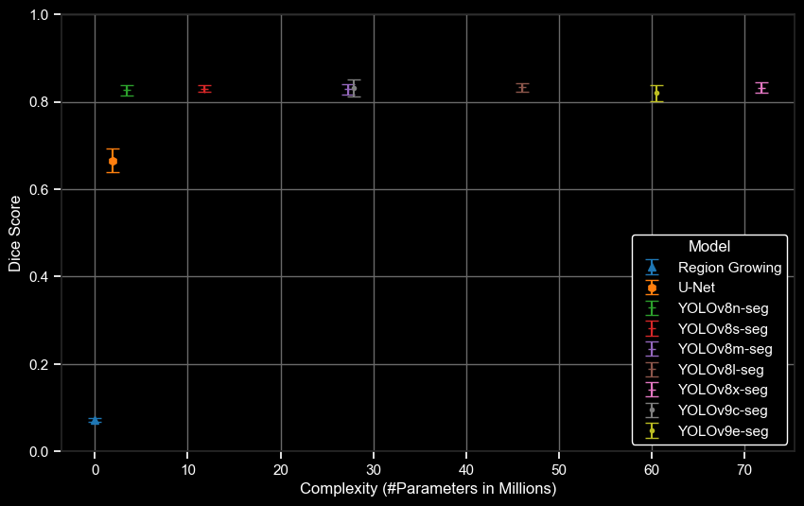
SEGMENTATION RESULTS
Dice Score
Complexity (#Parameters in Millions)

Slide 53
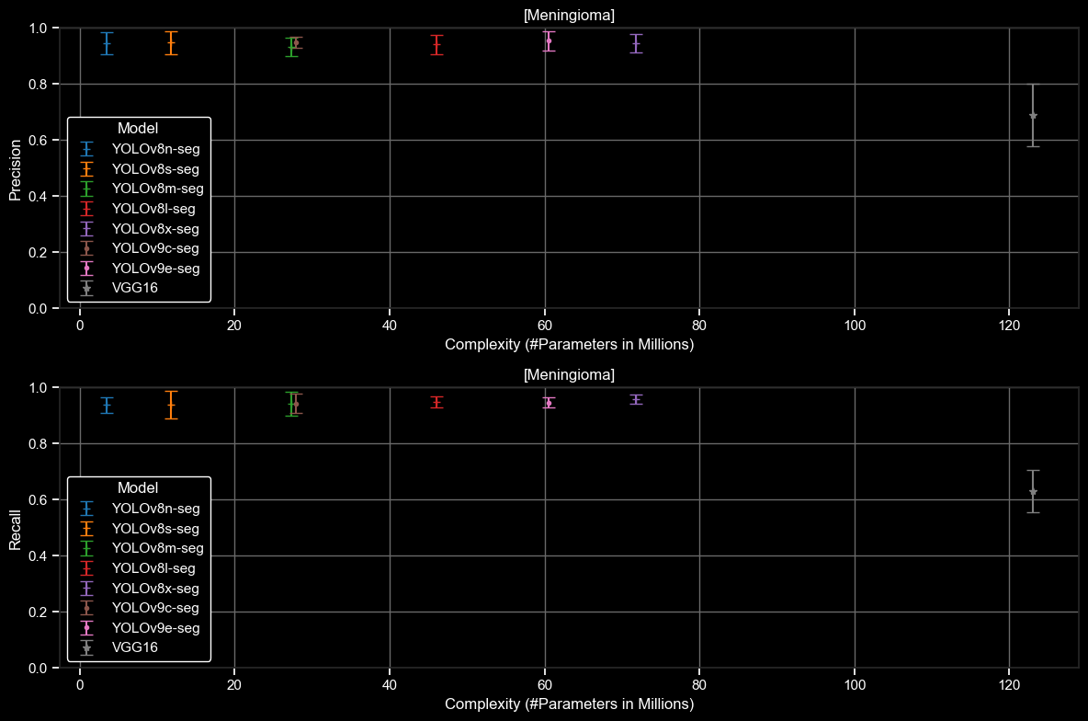
CLASSIFICATION RESULTS
MENINGIOMA

Slide 54
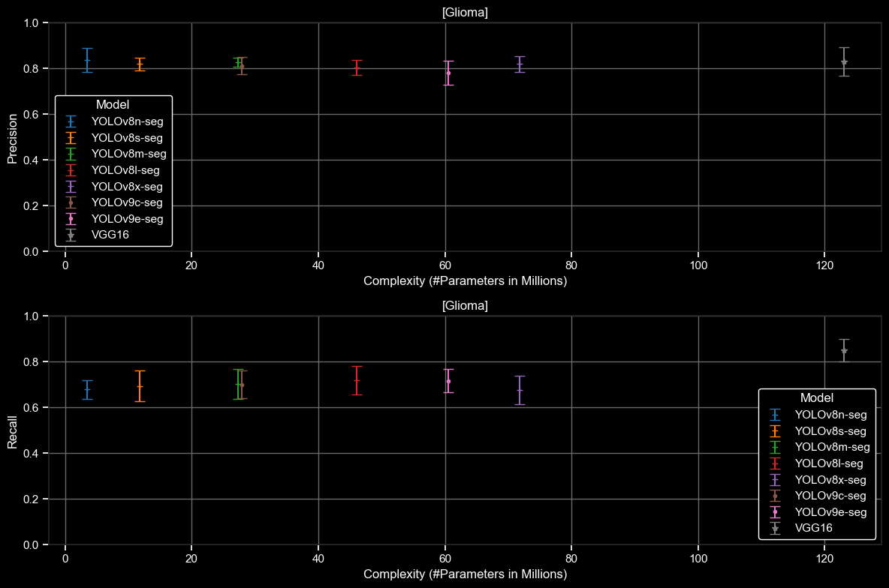
CLASSIFICATION RESULTS
GLIOMA

Slide 55
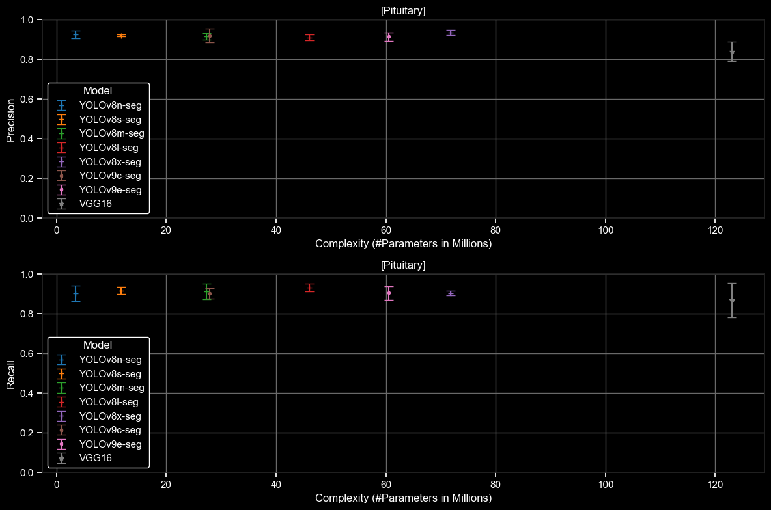
CLASSIFICATION RESULTS
PITUITARY

